Slide 1
Machine learning for aiding the diagnostic of pathology on the vertebral column
By Irene Cheung

Slide 2
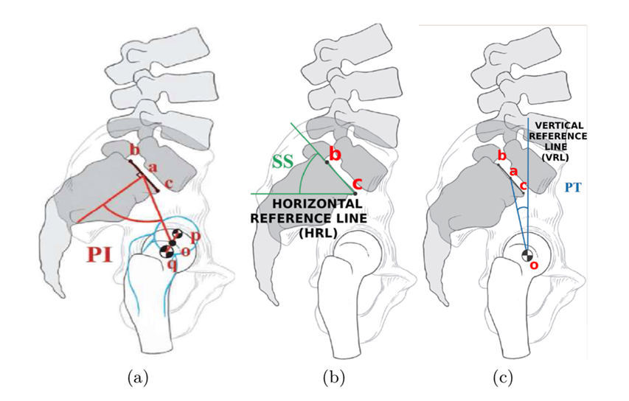
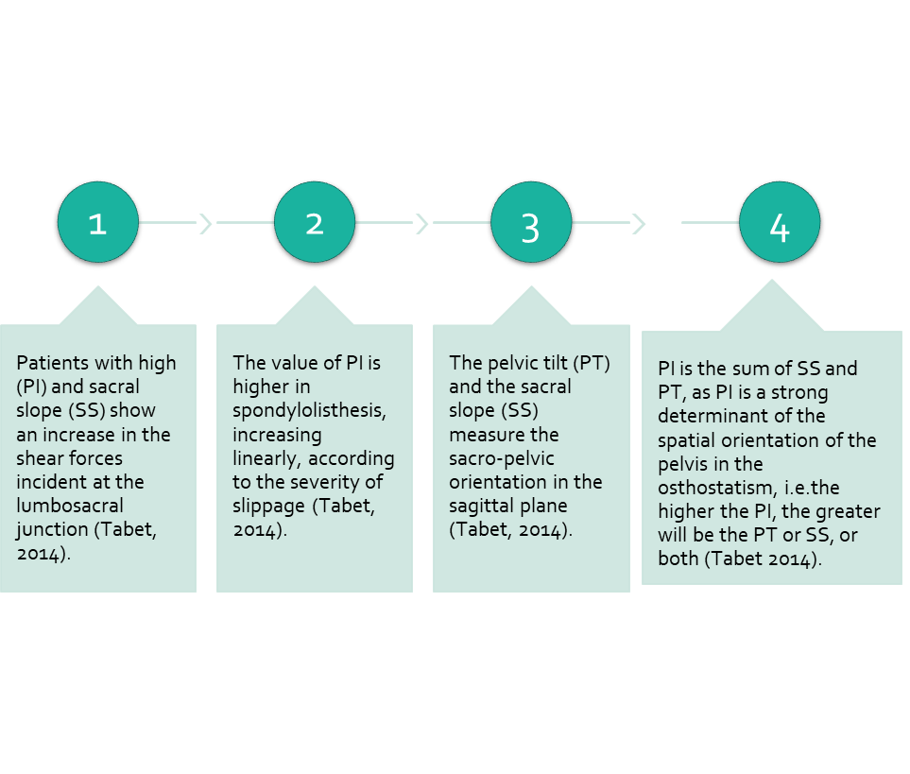

Objective
The purpose of study is applying machine learning to characterize pathologies of the vertebral column by using SIX biomechanical attributes derived from the shape and orientation of the pelvis and lumbar spine: Pelvic Incidence (PI), Pelvic Tilt (PT), Lumbar Lordosis Angle (LLA), Sacral Slope (SS), Pelvic Radius (PR) and Grade of Spondylolisthesis (GOS).
Understanding the relationships of these biomechanical characteristics are significantly importance for the discernment of vertebral column disorder in normal and pathologic (abnormal) conditions of the spine and pelvis.
Literature Review

Slide 3
Results #1- Pearson Correlation of Features
The highest correlation of Pelvic Incidence are sacral_slope (0.81), followed by lumbar_lordosis_angle (0.72), degree_spondylolisthesis (0.64) and pelvic_tilt_numeric (0.63)
Variables |  | Hypothesis | Correlation correlations
Pelvic Incidence (PI) | Sacral Slope (SS) | H1: Patients with high PI is higher impact on SS. | 0.81
 | Lumbar Lordosis Angle (LLA) | H2: Patients with high PI has higher Lumbar Lordosis Angle (LLA). | 0.72
 | Degree of spondylolisthesis | H3: Patients with high PI has higher risk of presenting a spondylolisthesis. | 0.64
 | Pelvic tilt numeric | H4: Patients with high PI has higher pelvic tilt numeric. | 0.63
It is used as a measure for quantifying linear dependence between two continuous variables X and Y. Its value varies from -1 to +1.

Slide 4
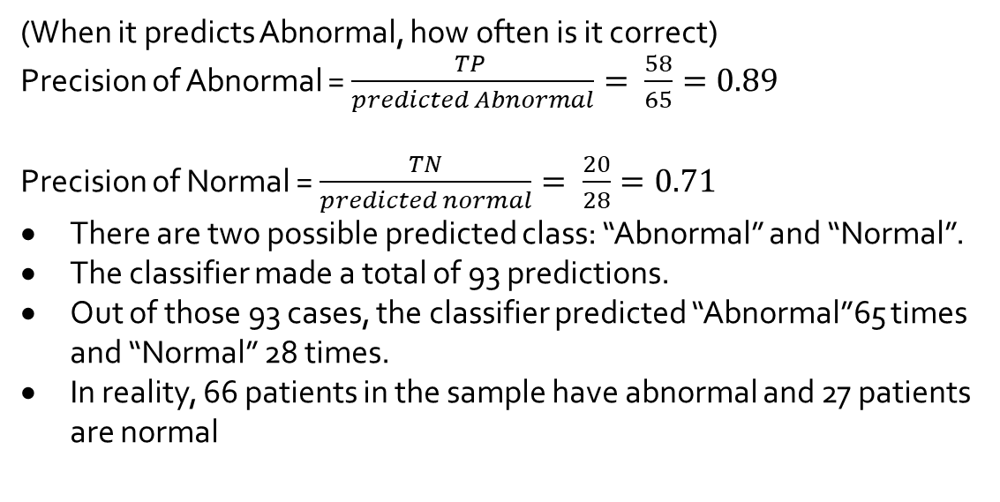
Results #2- Confusion matrix with random forest
N=93 (30% for test) | Predicted Abnormal | Predicted Normal
Actual Abnormal | TP=58 | FP=8 | 66
Actual Normal | FN=7 | TN=20 | 27
 | 65 | 28
TP: True Positive
TN: True Negative
(When it predicts Abnormal, how often is it correct)
Precision of Abnormal = $\frac{TP }{predicted Abnormal}= \frac{58}{65}=0.89$
Precision of Normal = $\frac{TN}{predicted normal}= \frac{20}{28}=0.71$
There are two possible predicted class: “Abnormal” and “Normal”.
The classifier made a total of 93 predictions.
Out of those 93 cases, the classifier predicted “Abnormal”65 times and “Normal” 28 times.
In reality, 66 patients in the sample have abnormal and 27 patients are normal

Slide 5
Results #3- ROC Curve with logistic regression
Logistic Regression is a classification algorithm. It is used to predict a binary outcome (1 / 0, Yes / No, True / False) given a set of independent variables.
Receiver Operating Characteristic(ROC) summarizes the model’s performance by evaluating the trade offs between true positive rate (sensitivity) and false positive rate(1- specificity).
The area under curve (AUC), referred to as index of accuracy(A) or concordance index, is a perfect performance metric for ROC curve. Higher the area under curve, better the prediction power of the model.
Notes:
To evaluate the performance of a logistic regression model,

Slide 6

Conclusions
Pelvic Incidence (PI) has a positive correlation (0.63–0.81) with Sacral Slope (SS), Lumbar Lordosis Angle (LLA), degree of spondylolisthesis and Pelvic tilt numeric.
The findings show a good agreement with literatures. As Pelvic Incidence (PI) is a constant anatomic pelvic variable given to each individual and greatly affects by the Sacral Slope (SS), Pelvic Tilt (PT), and Lumbar Lordosis, which are position-dependent variables. In this study proposes that pelvic anatomy has a direct impact on the development of a spondylolisthesis.
Therefore, patients with an increased pelvic incidence mean to be at higher risk of occurring a spondylolisthesis, and an increased PI could be a predominant factor leading to progress in developmental spondylolisthesis.
In this work, incorporate machine learning techniques can significantly help orthopaedist to diagnosis of pathologies on the Vertebral Column.

